Slide 1

E2EE Chat
(End-to-End encryption)
Olivier Tan

Slide 2
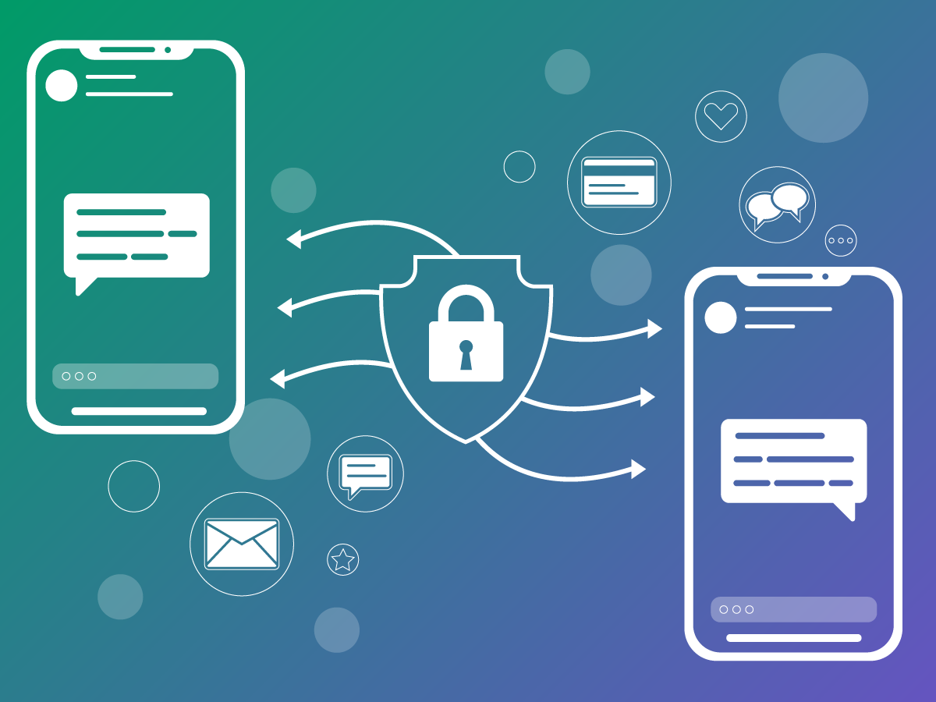
What is it?
Enables secure, real-time 1:1 communication between users.
Messages are end-to-end encrypted — only sender & receiver can read them.
Server cannot read, decrypt, or modify any message contents.

Slide 3

Why does it matter?
Most modern communication contains sensitive info (identity, finance, personal data)
Centralized platforms can be vulnerable to insider threats & surveillance
E2EE ensures privacy, confidentiality, and tamper protection
Inspired by real-world apps like Signal & WhatsApp — but with more transparency

Slide 4
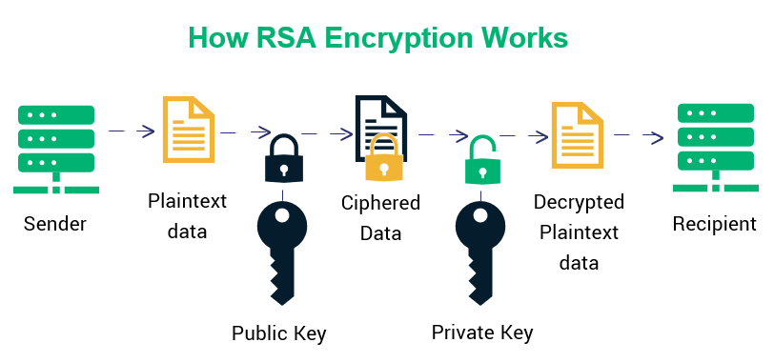
How it works

Slide 5
Demo

